Slide 1
Python Dictionary
DVT101 – Lecture 26
- By Dataverse Tutorials

Slide 2
Introduction to Python Dictionary
What is a Dictionary?
Key–Value data structure
Key must be unique
Value can be any data type
Faster lookup than lists

Slide 3
Why We Need Dictionaries
Store data with meaningful names
Faster searching than index-based lists
Real-life mapping example (ID → Record)
Used in configs, APIs, databases

Slide 4
Dictionary Syntax & Structure
Curly braces { }
Key : Value format
Comma-separated pairs
Keys must be immutable
Values can be any type

Slide 5

Program: Basic Dictionary Example
Demonstrates key–value storage
Shows dictionary print format
Helps understand mapping logic
Introduces real object storage

Slide 6
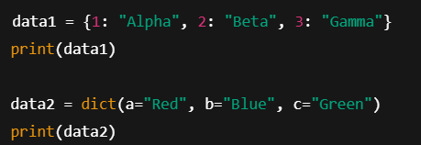
Creating Dictionary (Two Ways)
Using { } literal
Using dict() constructor
Mixed key types
Useful for dynamic creation

Slide 7
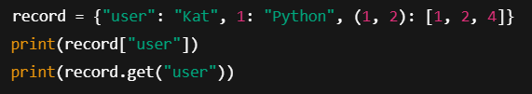
Program: Accessing Dictionary Values
Access via square brackets
Access via get() method
Handling missing keys safely
Demonstrates tuple key & list value

Slide 8
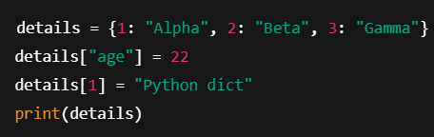
Adding & Updating Dictionary Items
New key assignment
Updating existing key
Dictionary auto-expands
Overwriting values

Slide 9
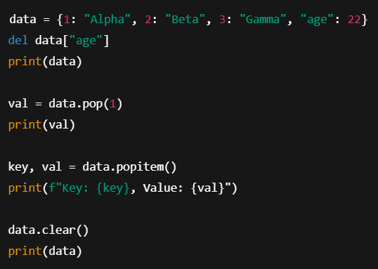
Program: Removing Dictionary Items
del for direct delete
pop() returns removed value
popitem() removes last pair
clear() empties dictionary

Slide 10
Iterating Through Dictionary
Loop through keys
Loop through values
Loop through key–value pairs
Using .keys(), .values(), .items()

Slide 11
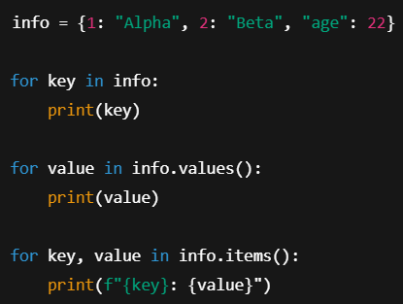
Program: Dictionary Iteration
Prints keys first
Then prints values
Then prints pairs
Shows loop behavior clearly

Slide 12
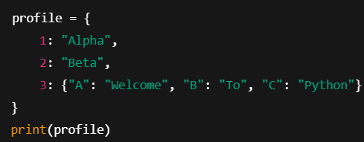
Nested Dictionaries
Dictionary inside dictionary
Used for structured data
Multi-level access
Example: user profile data

Slide 13
Internal Working of Dictionary
Hash table based
Keys converted to hash
Direct memory lookup
Very fast access

Slide 14
Real World & Industry Use
User profiles
API JSON responses
Configuration files
Machine learning feature maps

Slide 15
Summary & Key Takeaways
Key–value storage
Fast access
Mutable and flexible
Widely used in Python projects

Slide 16


